Slide 1
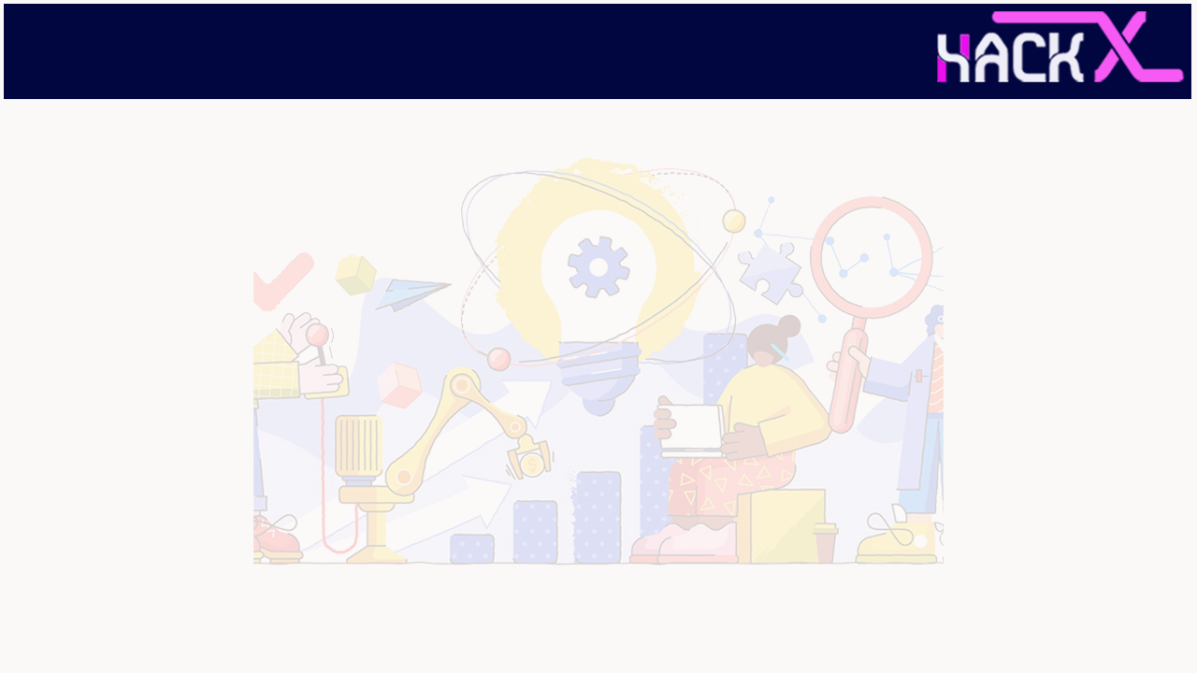
SLIDE 1
1.Team Name : Marvel Minds
2. Members Name and Phone Numbers :
L.Haritha (Leader) - 9500352896
Anusha R - 9361291316
Kaaviya DT - 9487716978
Teena T - 9445992452
3. Domain name : Internet of Things
4. Problem statement: IoT based app for checking the health of all patients via sensors in hospitals

Slide 2
SLIDE 2
ABSTRACT :
IoT in healthcare is the key player in providing better medical facilities to the patients and facilitates the doctors and hospitals as well.
The proposed system here consists of various medical devices such as sensors and web based or mobile based applications which communicate via network connected devices and helps to monitor and record patient’s health data and medical information.
The proposed outcome of the paper is to build a system to provide world-class medical aid to the patients even in the remotest areas with no hospitals in their areas by connecting over the internet and grasping information through about their health status via the wearable devices provided in the kit using a raspberry pi microcontroller which would be able to record the patient’s heart rate, blood pressure.
The system would be smart to intimate the patient’s family members and their doctor about the patient’s current health status and full medical information in case any medical emergency arises.

Slide 3
SLIDE 3
NOVELTY :
To obtain the real-time medical information about a patient via IoT( raspberry pi microcontroller)
unprocessed data from various IoT devices is obtained and stored on the server.
Processing and classification of information gathered about the patient.
To interpret and predict any disease or disorder in preliminary stage itself using the data mining techniques that will also provide the approach advantageous for decision making.
To provide Internet of Things based healthcare solutions at anytime and anywhere.

Slide 4
SLIDE 4
TECHNOLOGY STACK :
Raspberry pi (Using software – Apache2,PHP,MySQL,PHPMyadmin)
Temperature sensor
Heartbeat sensor
vibration sensor
ADC
GSM module
Programming language used - Java

Slide 5
SLIDE 5
HARDWARE / SOFTWARE IMPLEMENTATION :
Sensors work both in and out of the body. Here we use a sensor outside the body.
Heartbeat sensor:
The heart rate is measured by placing tip of forefinger upon the sensor. circuit senses the pulse and LED blinks along with pulse. The output is sent to micro-controller to measure heart beat rate in BPM
ADC:
Analog output of sensor are converted into digital form using convertor IC.
Raspberry pi:
Then raspberry pi reads the values from the sensors (by python code) and update it in database. Information is obtained as a from processing that data. data mining techniques to predict the type of the disease for which the system was designed. These info are sent to the app by steps given below:

Slide 6
SLIDE 6
Connecting raspberry pi to mobile app:
Create a Database using the software Phpmyadmin in raspberrypi and place the information files in directory.
Create the layout of app using software appstudio.
To run the app java coding is done.
Download the data , and send it using JSONparser(). This connects the server and sends the data to app.

Slide 7
SLIDE 7
BUSINESS SCOPE :
The proposed system can be set-up in the hospitals and massive amount of data can be obtained and stored in the online database. Even the results can be made to be accessed from mobile through an application. The system can be further improved further by adding artificial intelligence system components to facilitate the doctors and the patients.
SLIDE 1

